Slide 1

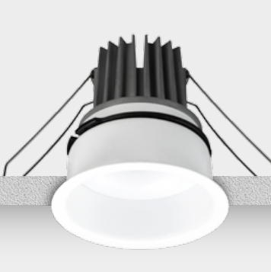






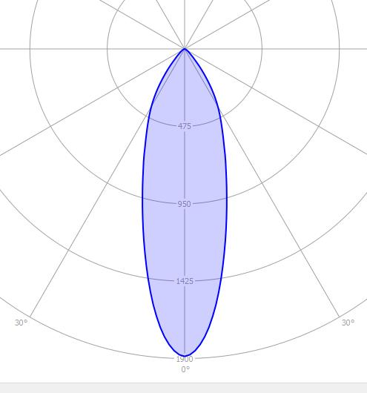
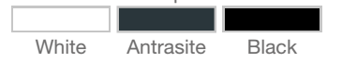


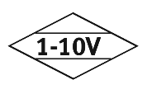
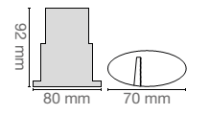


LED MODULE INTEGRATED SPOTLIGHTS
LIGHT.30.90.M
Order Code : L005002.3090M
Product Code : LIGHT.30.90.M
Features
Color : RAL
Body : Alumium
IP Grade : IP44
Installation : Recessed Mounted
Lighting Source : Mid Power LED
Performance Data
Power : 10 W
Flux : 781 lm
Efficiency :79 lm/W
Voltage : 220-240 V AC
Frequency : 50-60 Hz
Power Factor : > 0,9
CCT (K) : 3000 K
CRI : > 90
Photometric Curve
Color Options
Dimensions
www.siberled.com
İstanbul Yolu 26. Km Susuz mah. Yenimahalle / Ankara / Türkiye
T: +903123517686 siber@siberled.com

