Slide 1

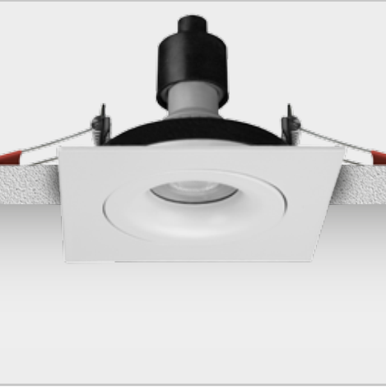





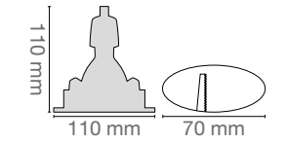

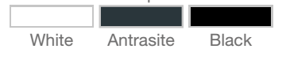


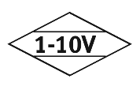


RETROFIT LAMB SPOTLIGHTS
G-LIGHT 105
Order Code : L005020
Product Code : G-LIGHT 105
Features
Color : RAL
Body : Alumium
IP Grade : IP20
Installation : Recessed Mounted
Lighting Source : MR16 /G10 LED Ampul
Performance Data
Voltage : 220-240 V AC
Frequency : 50-60 Hz
Dimensions
Color Options
www.siberled.com
İstanbul Yolu 26. Km Susuz mah. Yenimahalle / Ankara / Türkiye
T: +903123517686 siber@siberled.com

